Slide 1

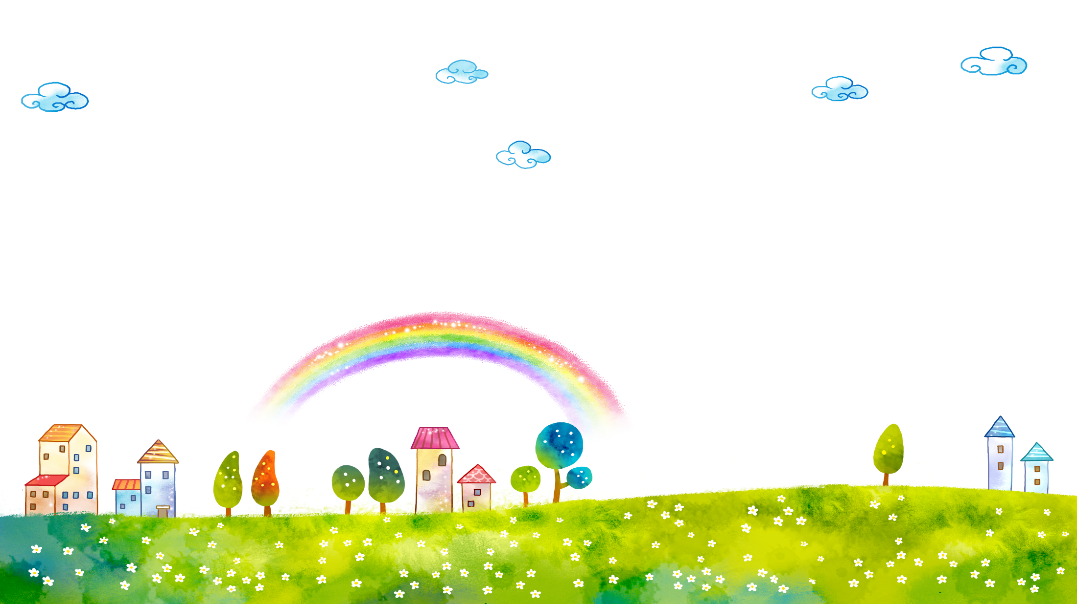
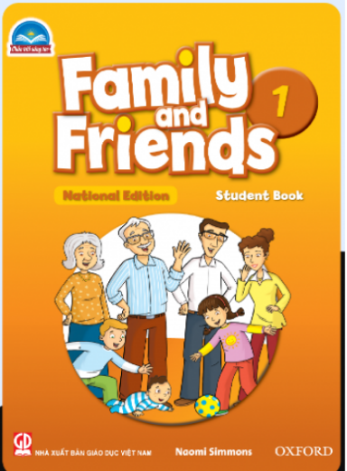

FAMILY and FRIENDS 1
National Edition

Slide 2





Unit 1: What color is it?
Lesson Two Grammar & Song

Slide 3





WARM UP

Slide 4




LISTEN and REPEAT
Notes:
Show students a picture and ask “What color is it?”
Students answer with the colors they have learned in the last lesson

Slide 5



Slide 6
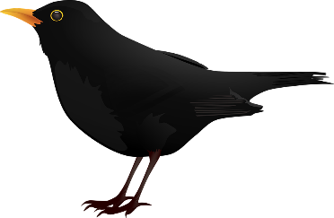

Slide 7


Slide 8


Slide 9
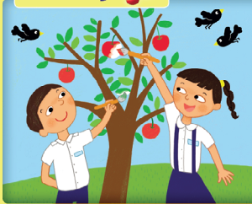

Notes:
- Point to a leaf in the picture and ask: What color is it?
- Say: It’s green.
- Continue with other items in the picture

Slide 10



Who’s faster ?

Slide 11

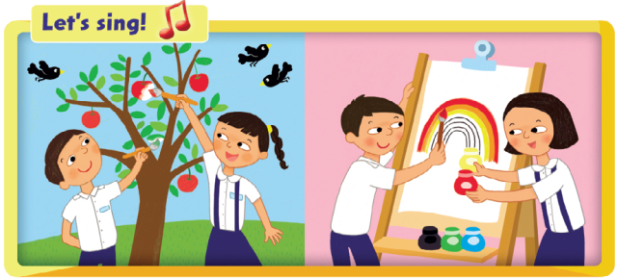

Notes:
Say “Let’s sing!” and play the recording for the children to listen to
Play the recording again and sing along.
• Below level:
Stick a flashcard on a wall for children to point to, and continue sticking up one card at a time (and in order) each time they sing the whole song.
• At level:
Stick the flashcards 6–9 around the room, and have children point to the correct flashcard as they sing the line with the color.
• Above level:
Hand out Flashcards 6–9 to children in different places around the room. The children stand up with their card when they hear their color.
Children hand the flashcards to other students around the class and sing again. Repeat as many times as you wish.

Slide 12



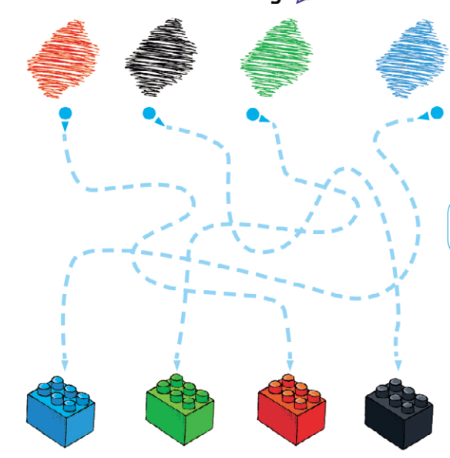
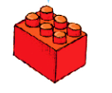







Trace the lines and say.
Notes:
Trace the lines and say
- Point to the red color patch. Say “What color is it?”
- Follow the path of the dotted line until you reach the red block below. Say “It’s red.”
- Continue with black, green , blue

Slide 13

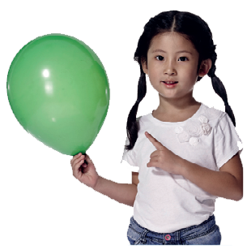
Let’s talk !
Notes:
LET’S TALK
- Students work in pair to ask and answer
- Move around to help

Slide 14







My color wheel
Notes:
GAME FOR REST

Slide 15







WHAT COLOR IS IT ?
IT’S BLUE.

Slide 16


WHAT COLOR IS IT ?
IT’S GREEN.

Slide 17

WHAT COLOR IS IT ?
IT’S RED.

Slide 18

WHAT COLOR IS IT ?
IT’S BLACK.

Slide 19


Goodbye!

